Slide 1
Sprint Review
Analyzing Facebook Data Using R Packages

Slide 2
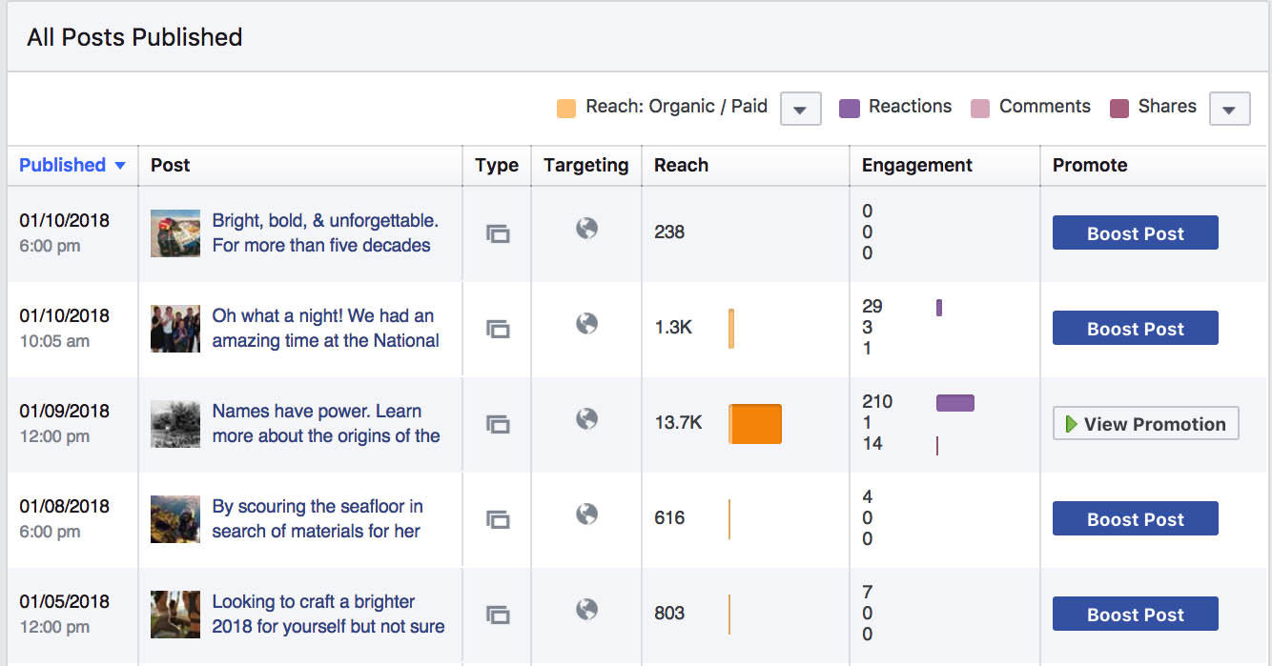
Extracting Facebook Data

Slide 3
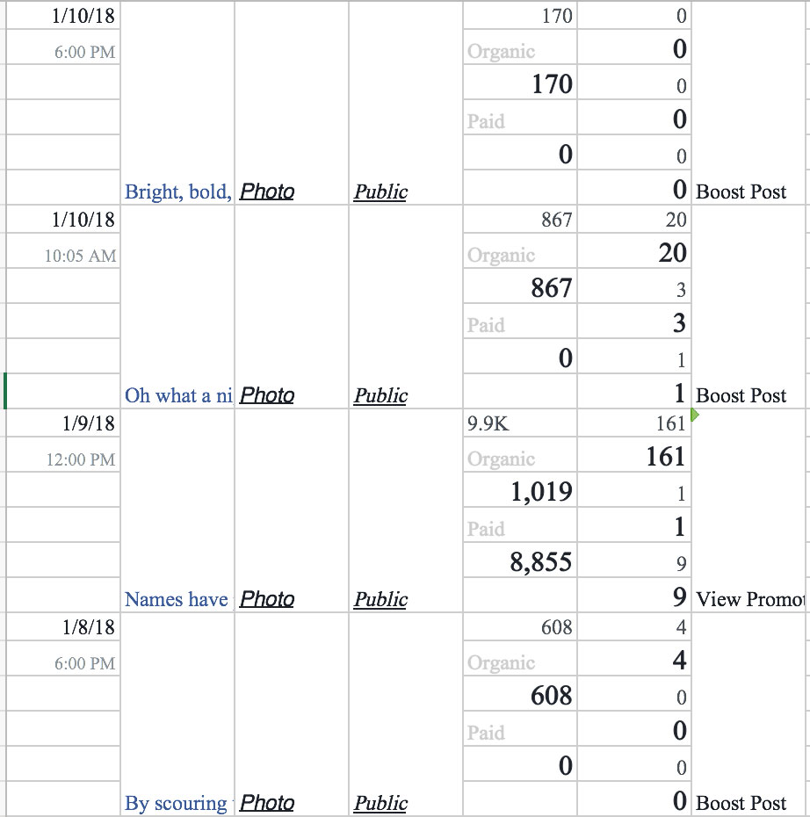
How I Used to Do This…
Notes:
Cutting and pasted from the Insights page leads to this.

Slide 4
New Process to Download Facebook Post Data
1.) Install Rfacebook packages.
2.) Created a stored token to be able to login to Facebook. (This is needed even to access public data.)
3.) Write the data frame to a new .CSV file.

Slide 5
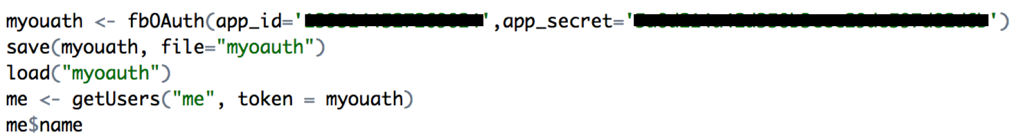
Code to Download Facebook Post Data (Part I)
How to install and access the R Facebook library.
In order to access data for either your individual Facebook account or data from a public page, a token must be used to access Facebook. This assumes you have set up your account accordingly on the Facebook Developer page.

Slide 6
Code to Download Facebook Post Data (Part II)
In order to get a view of the Facebook post data, use the getPage function and set to a table named "getpagedata.”
Write the dataset to a file on your local machine.

Slide 11
Top posting times:
5pm
2pm
7pm

Slide 18
Fin

